Slide 1
Water Level Indicator
By,
Manoj .R(21BCS170)
MUTHU KUMARA SAMY S(21BCS171)

Slide 2
Problem Statement:
The drinking water crisis in Asia is reaching alarming proportions. It might very soon attain the nature of global crisis.
Hence, it is of utmost importance to preserve water for human beings. In many houses there is unnecessary wastage of water due to overflow in overhead tanks.
Automatic Water Level Indicator and Controller can provide a solution to this problem

Slide 3
Introduction:
A water level indicator is a system that relays information back to a control panel to indicate whether a body of water has a high or low water level.
Some water level indicators use a combination of probe sensors or float switches to sense water levels.
It is used to show the level of water in an overhead tank, this keep the user informed about the water level at all the time and avoids the situation of water running out when it is most needed.
Indicator circuit also has alarm feature. It not only indicate the amount of water present in overhead tank but also gives an alarm when the tank is full.

Slide 4
System Requirements:
Arduino Uno R3
LCD Display
I2C Module
Buzzer
9V Battery
Water Level Sensor
Arduino IDE

Slide 5
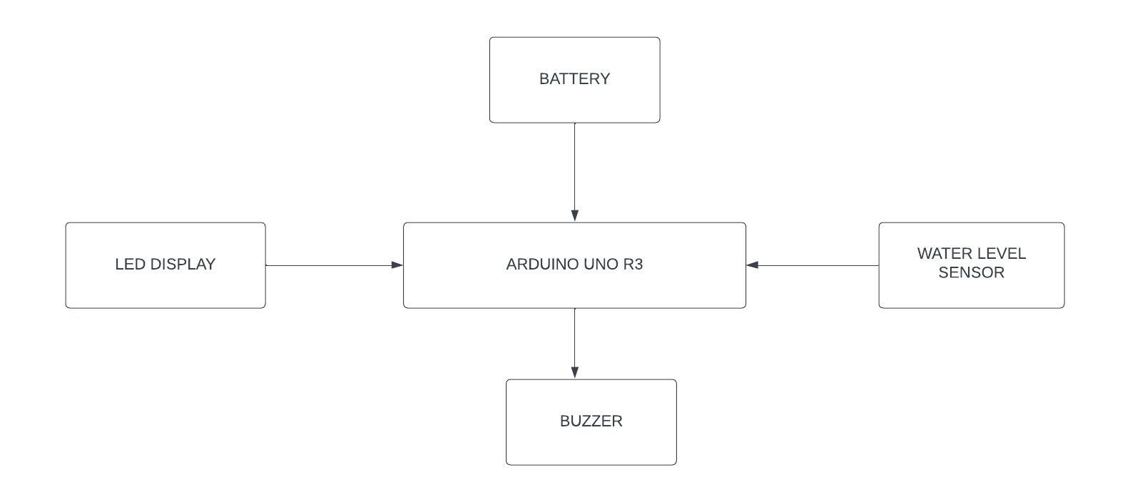
System Design:

Slide 6
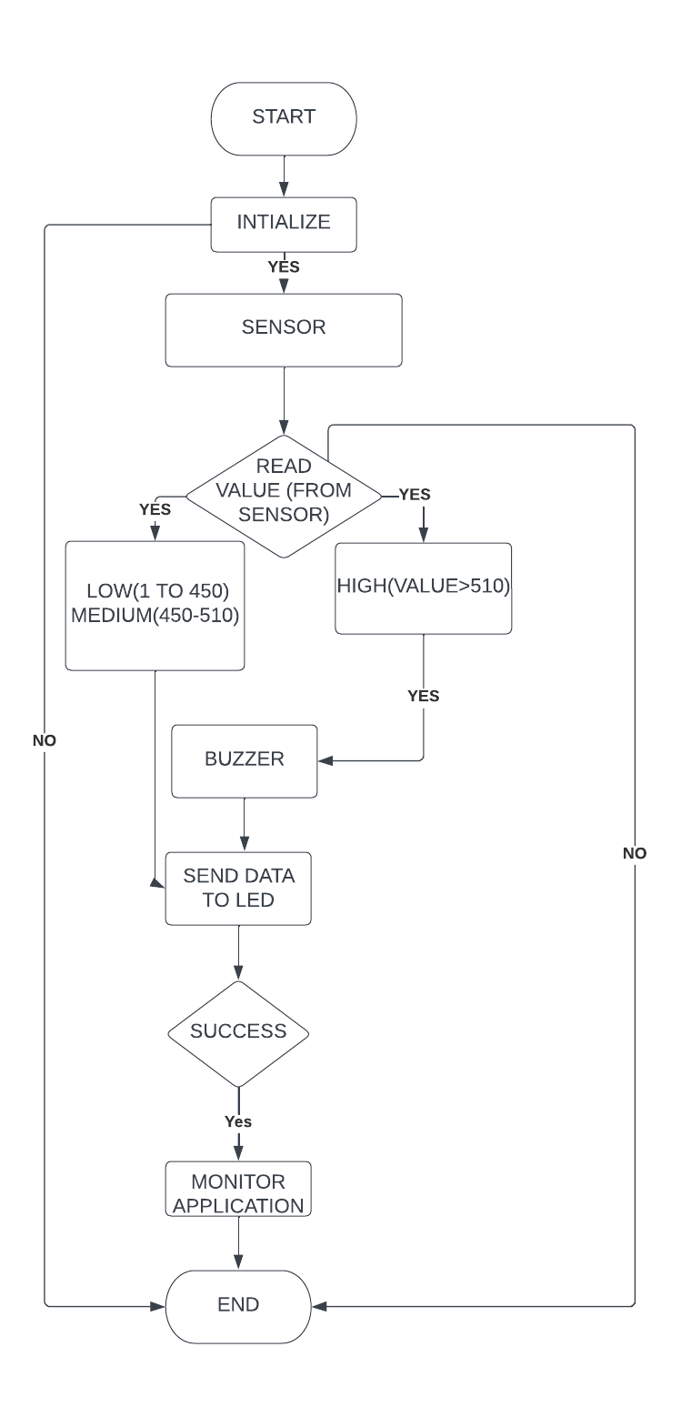
FLOW CHART:

Slide 7
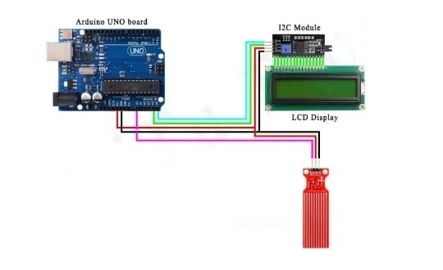
Circuit Diagram:

Slide 8

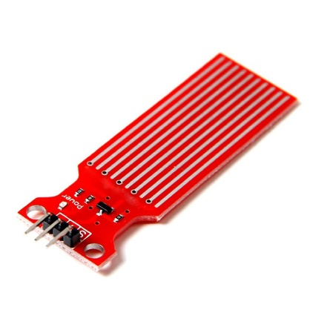
Main Requirements:
WATER LEVEL SENSOR
ARDUINO UNO

Slide 9
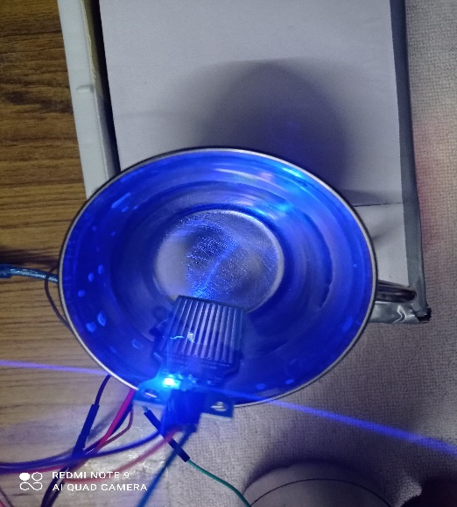
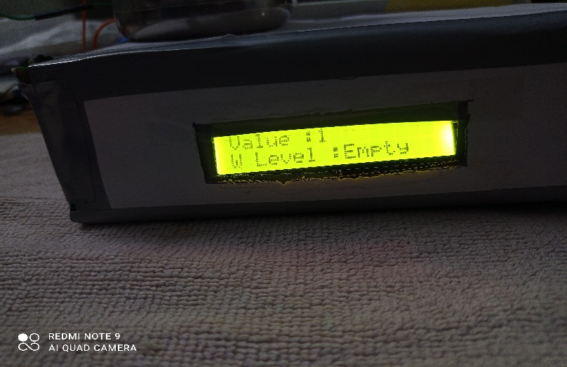
Working Process:

Slide 10
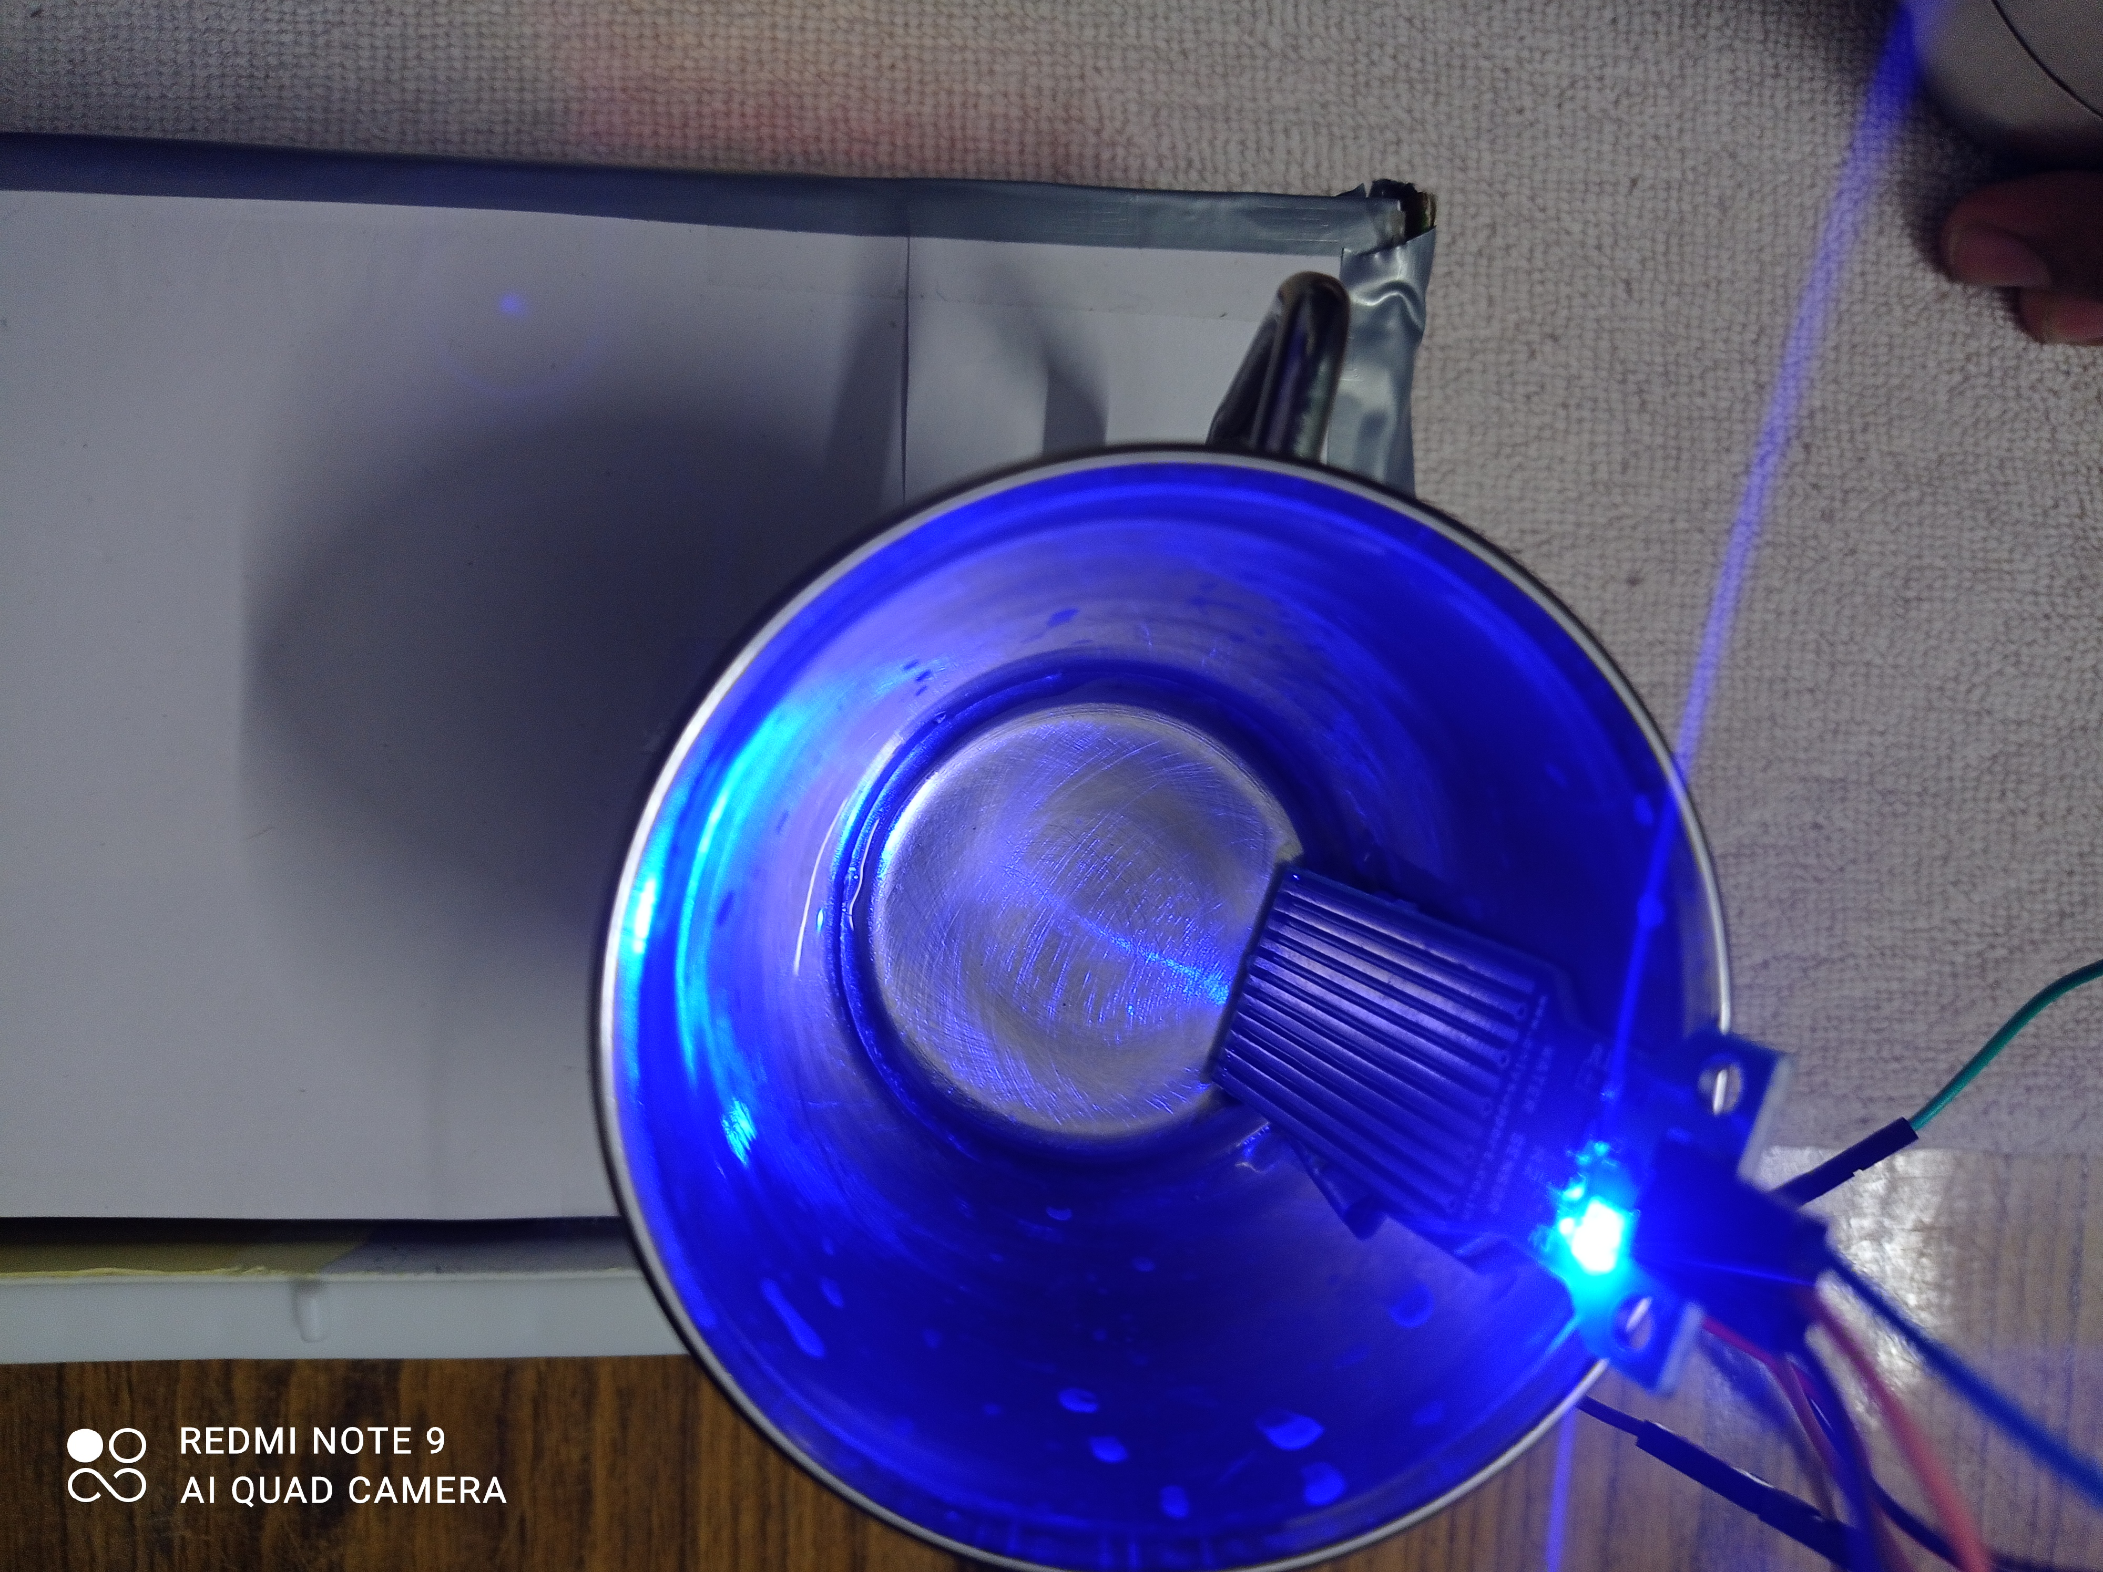
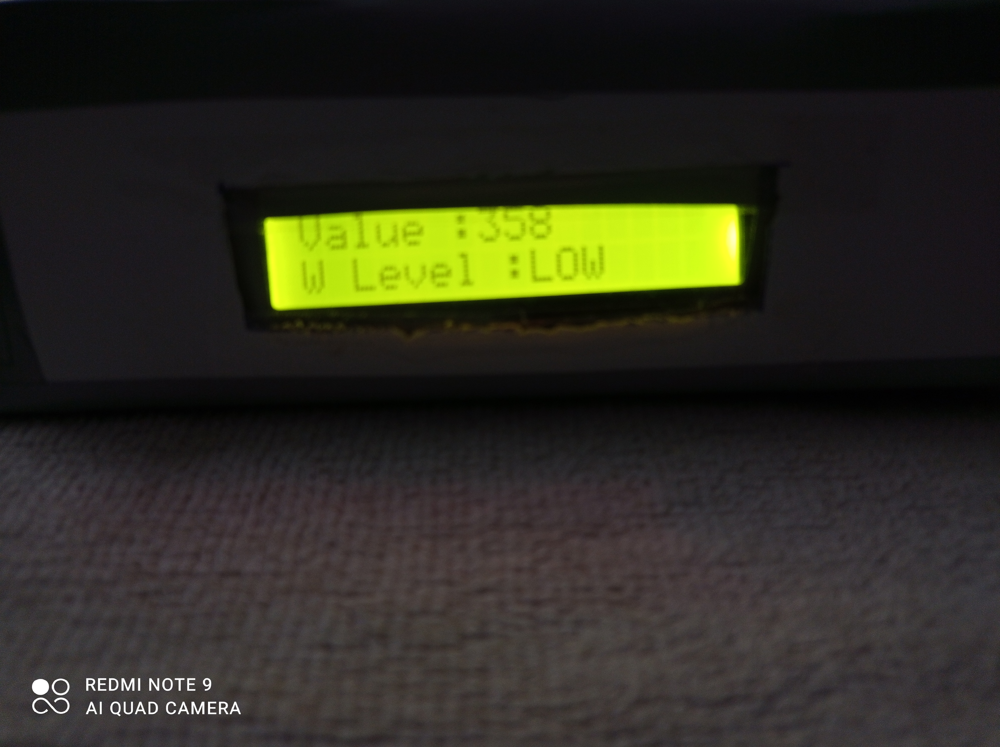
LOW

Slide 11

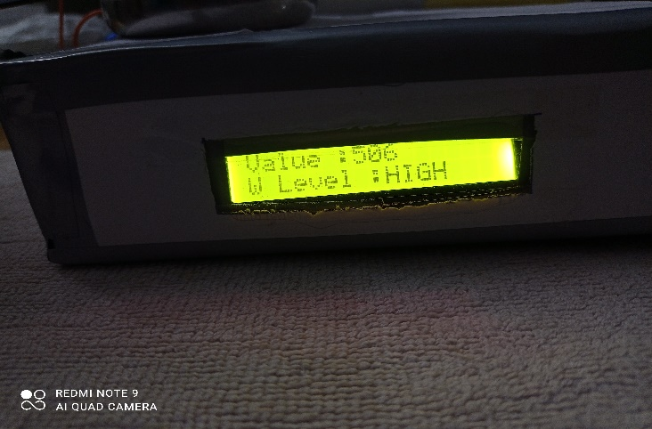
High:

Slide 12
Limitations:
Heating Problem due to stray capacitances.
Neck Strain

Slide 13
Conclusion:
This project was intended to design a simple and low cost water level indicator.
This is not only for water tank but also used for oil level and chemical lab.
To design this system, we used transistor as a platform and local materials for low cost.
We tried to design a system in such a way that its components will be able to prevent the wastage of water.
The whole system operates automatically.

